Slide 1

Artificial Intelligence
Lecture 8
By/ aly maher abdelfattah

Slide 2
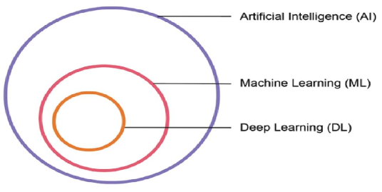
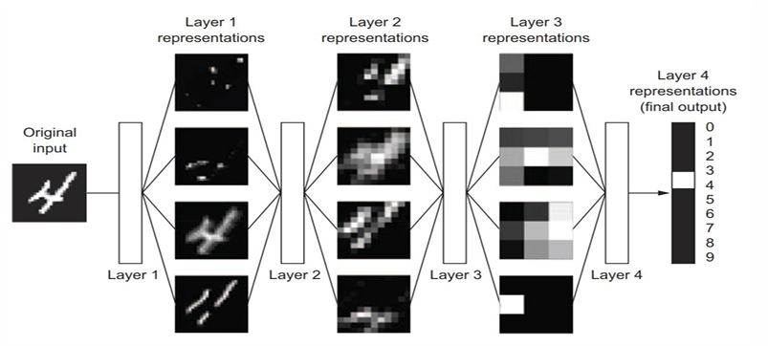
Deep Learning
Deep learning is a specific subfield of machine learning: learning representations from data that puts an emphasis on learning successive layers of increasingly meaningful representations.
How many layers contribute to a model of the data is called the depth of the model.
Also, called layered representations learning and hierarchical representations learning.
Modern deep learning often involves tens or even hundreds of successive layers of representations

Slide 3
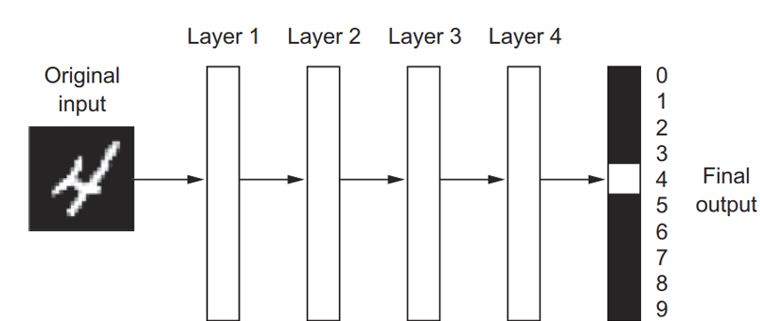
Deep Learning
In deep learning, the layered representations are (almost always) learned via models called neural networks, where layers stacked on top of each other.
The term neural network is a reference to neurobiology.

Slide 4
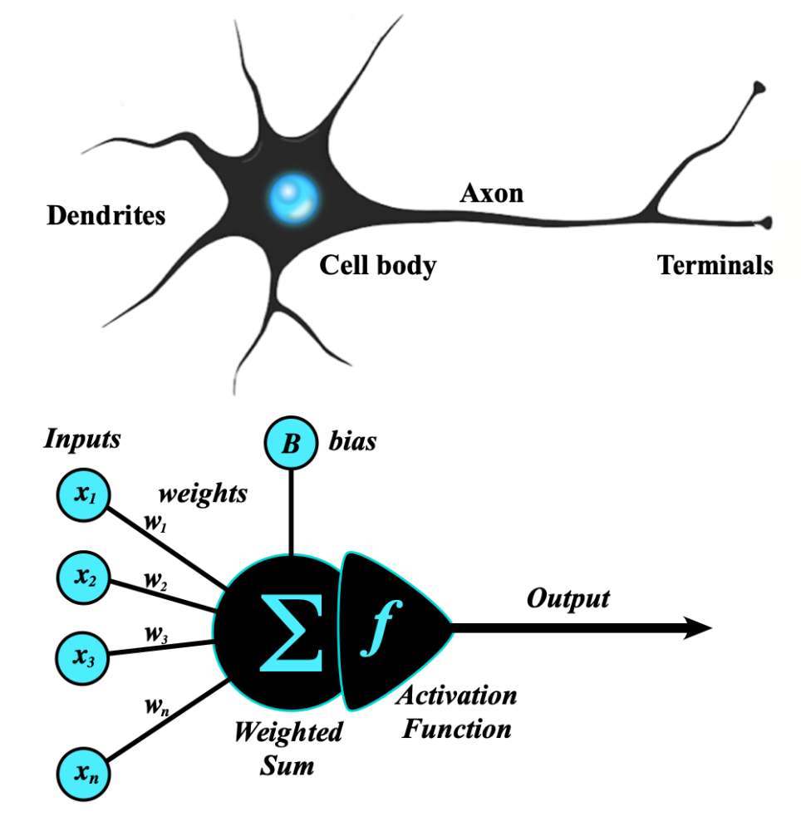
Traditional Neural Network
Artificial Neural Networks(ANN) are part of supervised machine learning where we will be having input as well as corresponding output present in our dataset.
ANN can be used for solving both regression and classification problems.
Neural networks form the base of deep learning,
Neural networks take input data, train themselves to recognize patterns found in the data, and then predict the output for a new set of similar data.
Therefore, a neural network can be thought of as the functional unit of deep learning, which mimics the behavior of the human brain to solve complex data driven problems.

Slide 5
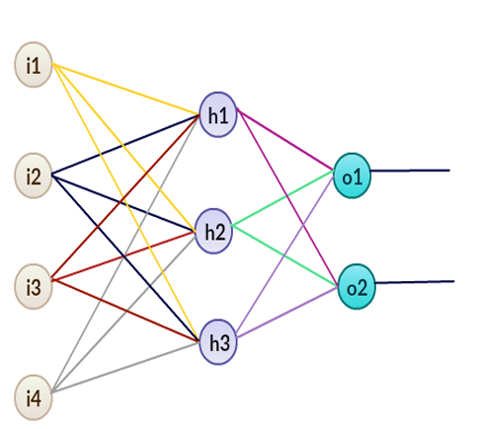
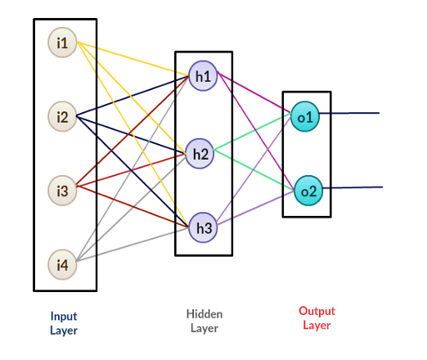
General Structure of ANN

Slide 6
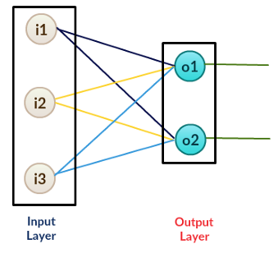
Perceptron
A perceptron is a neural network without any hidden layer. A perceptron only has an input layer and an output layer.

Slide 7
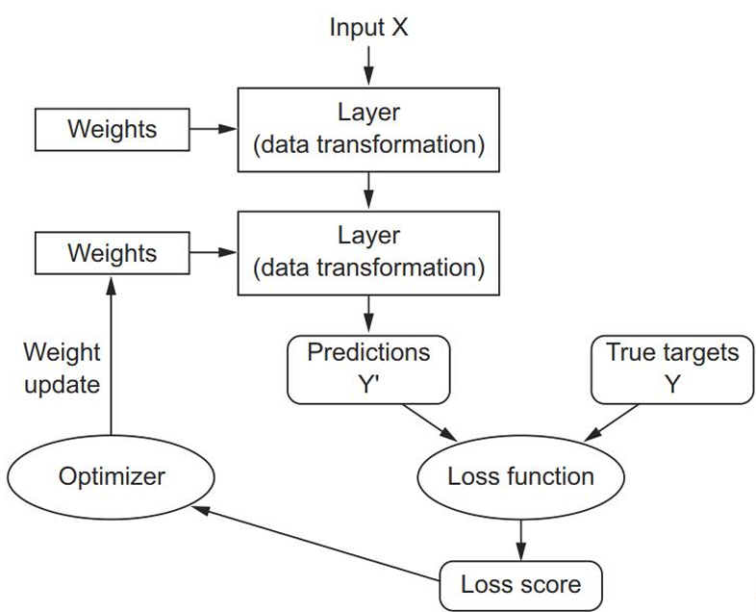
Steps involved in the implementation of a neural network
1. Feedforward:
we have a set of input features and some random weights. Notice that in this case, we are taking random weights that we will optimize using backward propagation.
2. Backpropagation:
we calculate the error between predicted output and target output and then use an algorithm (gradient descent) to update the weight values.

Slide 8
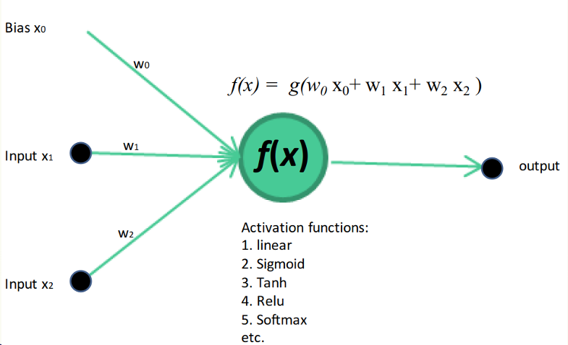
Perceptron Example

Slide 9
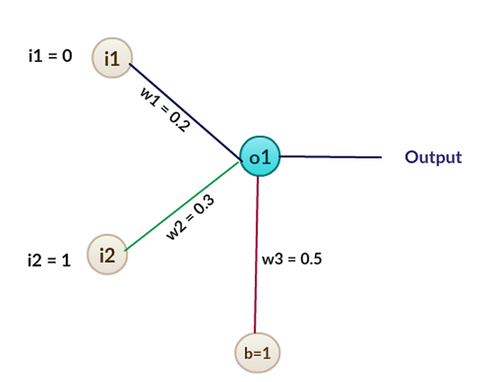
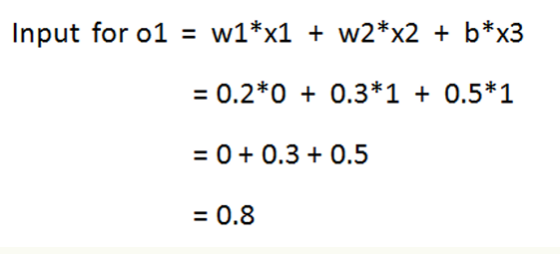
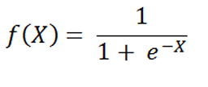
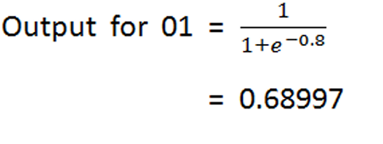


Example

Slide 10

Thank you

